Slide 1
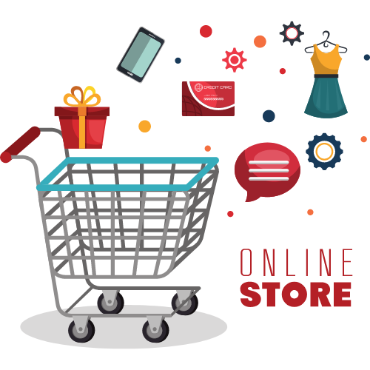
ONLINE STORE REVENUE ANALYSIS

Slide 2
Business problem
Problem 1:
From my level 1 analysis I found customer cancellation percentage Is very high.
Cancellation % - 39.17%
Problem 2:
our realized revenue is very low to compare overall revenue.
Overall revenue – 233.65 million
Realized revenue-62.63 million

Slide 3
TARGET
Reduce customer cancellation.
Increase the revenue.

Slide 4
Common reason for customer cancel their order:
1.Reduce customer cancellation
Change of Mind: Customers may change their minds about the product or service they have ordered, or may find a better deal elsewhere.
Technical Issues: Technical issues such as website errors, payment failures or glitches in the ordering process may also lead to cancellation of orders.
Delayed Delivery: If the delivery of the product or service is delayed beyond the expected time, customers may choose to cancel their order.
Hidden Fees: If customers feel they are being charged hidden or unexpected fees, they may choose to cancel their order.
Incorrect Product Information: If customers receive different product than what they ordered or if the product information is incorrect, they may choose to cancel their order.
Poor Customer Service: If customers experience poor customer service, they may cancel their order and choose to shop with a competitor.

Slide 5
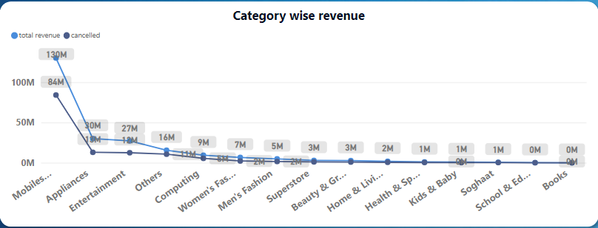
Category wise analysis
Above image shows relationship between product categories wise revenue and cancellation
Especially mobiles and tablets are making more revenue as well as cancellation also very high .

Slide 6
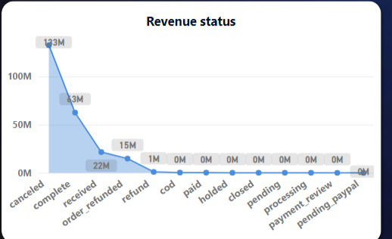
Revenue status

Slide 7
Solution
Provide Accurate Product Information: Ensure that all product descriptions, images and specifications are accurate and detailed to avoid any confusion or disappointment.
Improve Customer Service: Provide exceptional customer service through timely and helpful responses to queries, providing support through multiple channels, and addressing customer concerns promptly.
Offer Incentives for Completing Orders: Provide discounts, free shipping, or other incentives to customers who complete their orders to encourage them to complete the purchase.
Improve Delivery Times: Ensure that delivery times are accurate and realistic and provide customers with real-time tracking information to keep them informed about their orders.
Personalize Customer Experience: Use data to personalize customer experience and provide relevant recommendations and promotions based on their browsing and purchase history.
Improve Payment Processes: Streamline payment processes and ensure that payment options are secure, reliable and easy to use.

Slide 8
2.Revenue
How to increase revenue?
Increase Sales
Raise Prices
Improve Marketing
Focus on Customer Retention
How to implement above strategies effectively?
RFM ANALYSIS

Slide 9
RFM ANALYSIS
RFM analysis is a data-driven marketing technique that is used to segment customers based on their past purchase behaviour. RFM stands for Recency, Frequency, and Monetary value, and these are the three key metrics used to evaluate customer behaviour.
Recency: This metric measures how recently a customer has made a purchase. Customers who have made a purchase recently are more likely to make another purchase, compared to those who made a purchase a long time ago.
Frequency: This metric measures how often a customer has made a purchase. Customers who make purchases frequently are more likely to be loyal customers and generate more revenue.
Monetary value: This metric measures how much a customer has spent on purchases. Customers who spend more are more valuable to the business and may warrant special treatment or incentives.

Slide 10
RFM ANALYSIS
I just split all customers into 6 categories
“Champions” – person who is purchasing recently , fluently and spend more money.
“Loyal customers” – person who is purchasing recently and fluently.
“Big spenders“– person who is spend more money.
“Frequent customers” – person who is purchase frequently.
“Recent customers” – person who is purchase product recently.
“Potential loyalists” - person who is not purchasing product recently , fluently and not spend more money.

Slide 11
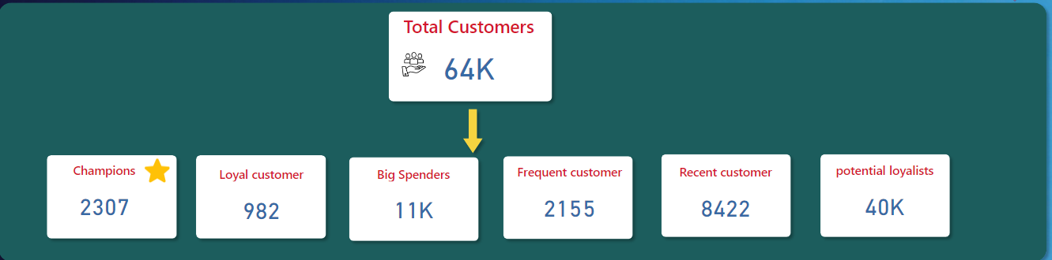
MARKETING STRATEGIES
Advertisement.
Discount\coupons.
Customer service.
New product promotion.
Personalized message.
Follow up.

Slide 12
THANK YOU

